Slide 1
scrum framework
COMP6100001 - Software engineering
Session 04
Kenny Jingga, S.Kom., M.T.

Slide 2
Session 04 – scrum framework
Learning objectives
At the end of this session, students will be expected to be able to:
Explain the Core Components of the Scrum Framework
Analyze the Benefits and Challenges of Scrum Implementation

Slide 3
Session 04 – scrum framework
Content outline
Scrum framework overview
Scrum roles
Scrum artifacts
Scrum events
User stories
Benefits & challenges of Scrum

Slide 4
AGILE Framework: Scrum
Scrum
Scrum is a lightweight framework that helps people, teams and organizations generate value through adaptive solutions for complex problems
The Scrum framework is purposefully incomplete, only defining the parts required to implement Scrum theory
Scrum is built upon by the collective intelligence of the people using it. Rather than provide people with detailed instructions, the rules of Scrum guide their relationships and interactions.
Various processes, techniques and methods can be employed within the framework. Scrum wraps around existing practices or renders them unnecessary. Scrum makes visible the relative efficacy of current management, environment, and work techniques, so that improvements can be made.

Slide 5
Scrum
Fundamental and pillars
Scrum is founded on empiricism and lean thinking
Empiricism → asserts that knowledge comes from experience and making decisions based on what is observed
Lean thinking → reduces waste and focuses on the essentials
Scrum employs an iterative, incremental approach to optimize predictability and to control risk
Empirical Scrum pillars → transparency, inspection, and adaptation

Slide 6
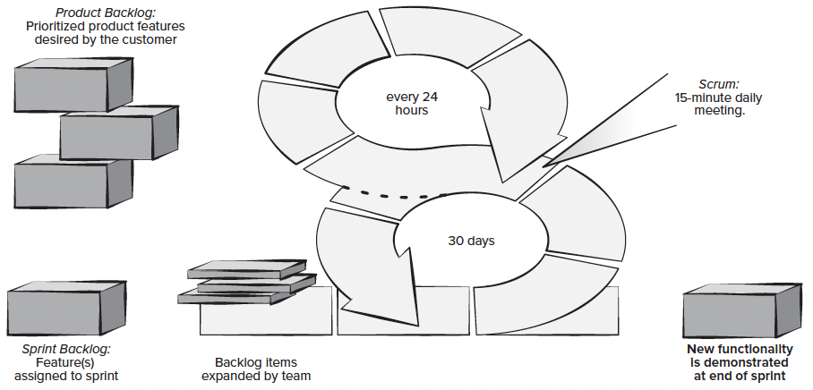
Agile Framework: Scrum
Scrum

Slide 7
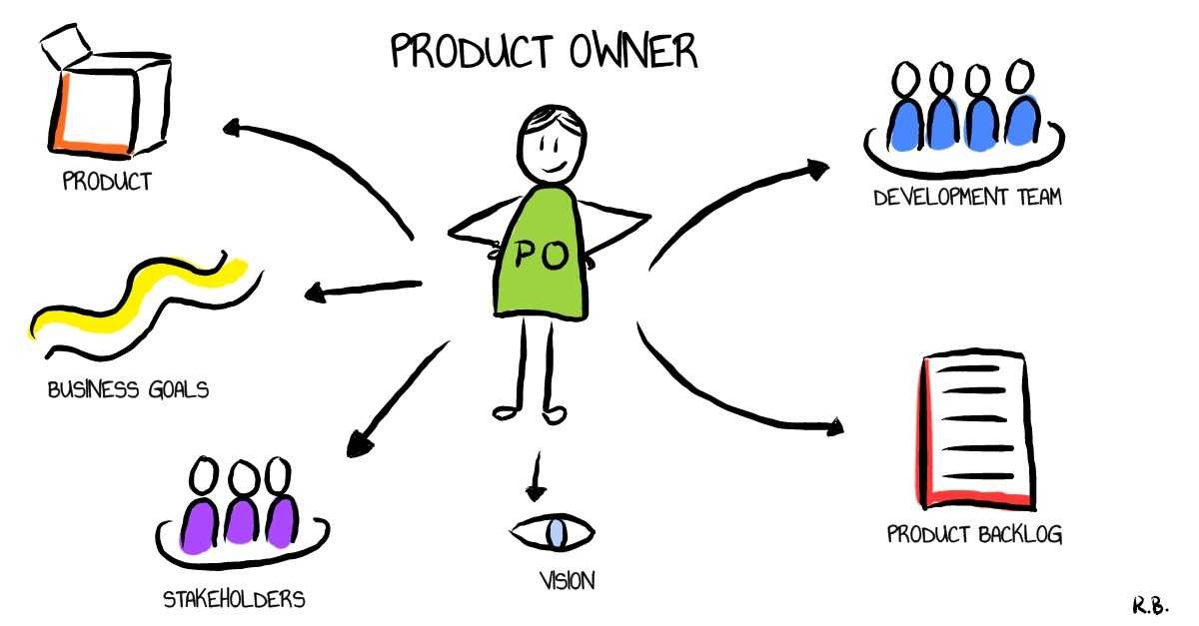
Scrum roles
Product owner
Responsibilities:
Defines the product vision.
Manages the Product Backlog.
Prioritizes needs based on stakeholder input and business value.
Ensures the team delivers value to the business.
Skills Needed:
Strong communication and negotiation skills.
Understanding of customer needs and market trends.

Slide 8
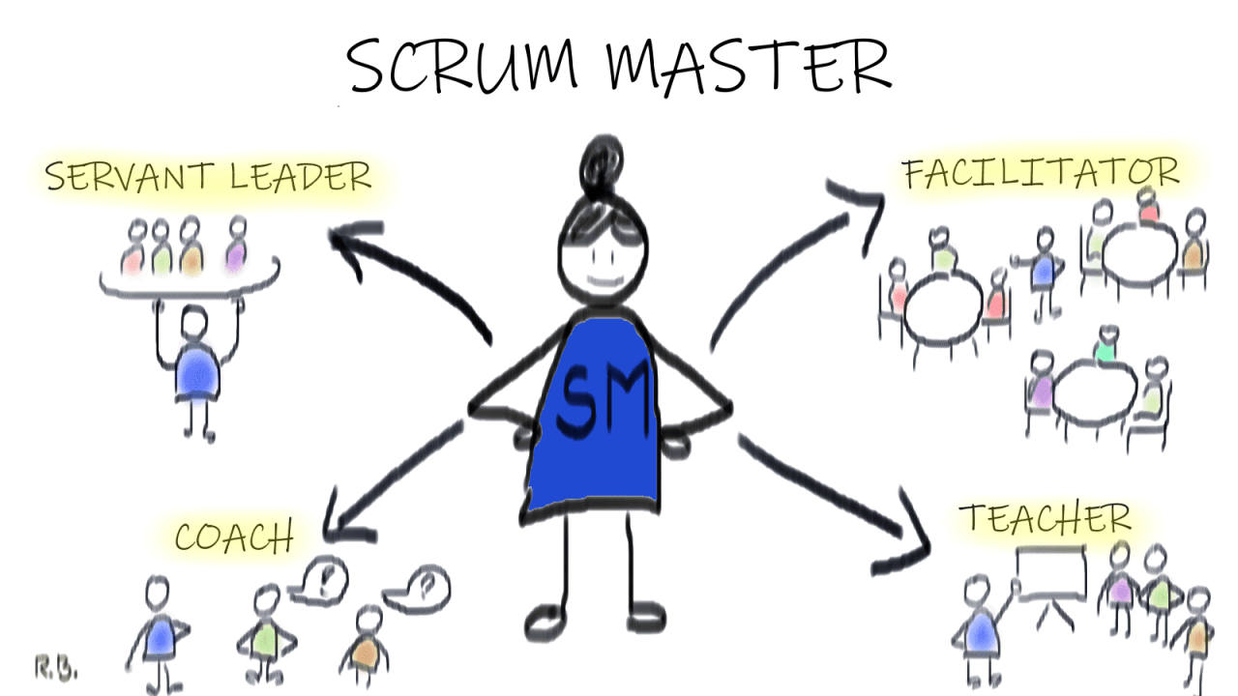
Scrum roles
Scrum Master
Responsibilities:
Facilitates Scrum events and processes.
Removes impediments to the team's progress.
Coaches the team in Scrum practices.
Serves as a servant leader to the Development Team.
Skills Needed:
Knowledge of Agile and Scrum principles.
Strong facilitation and conflict resolution skills.

Slide 9
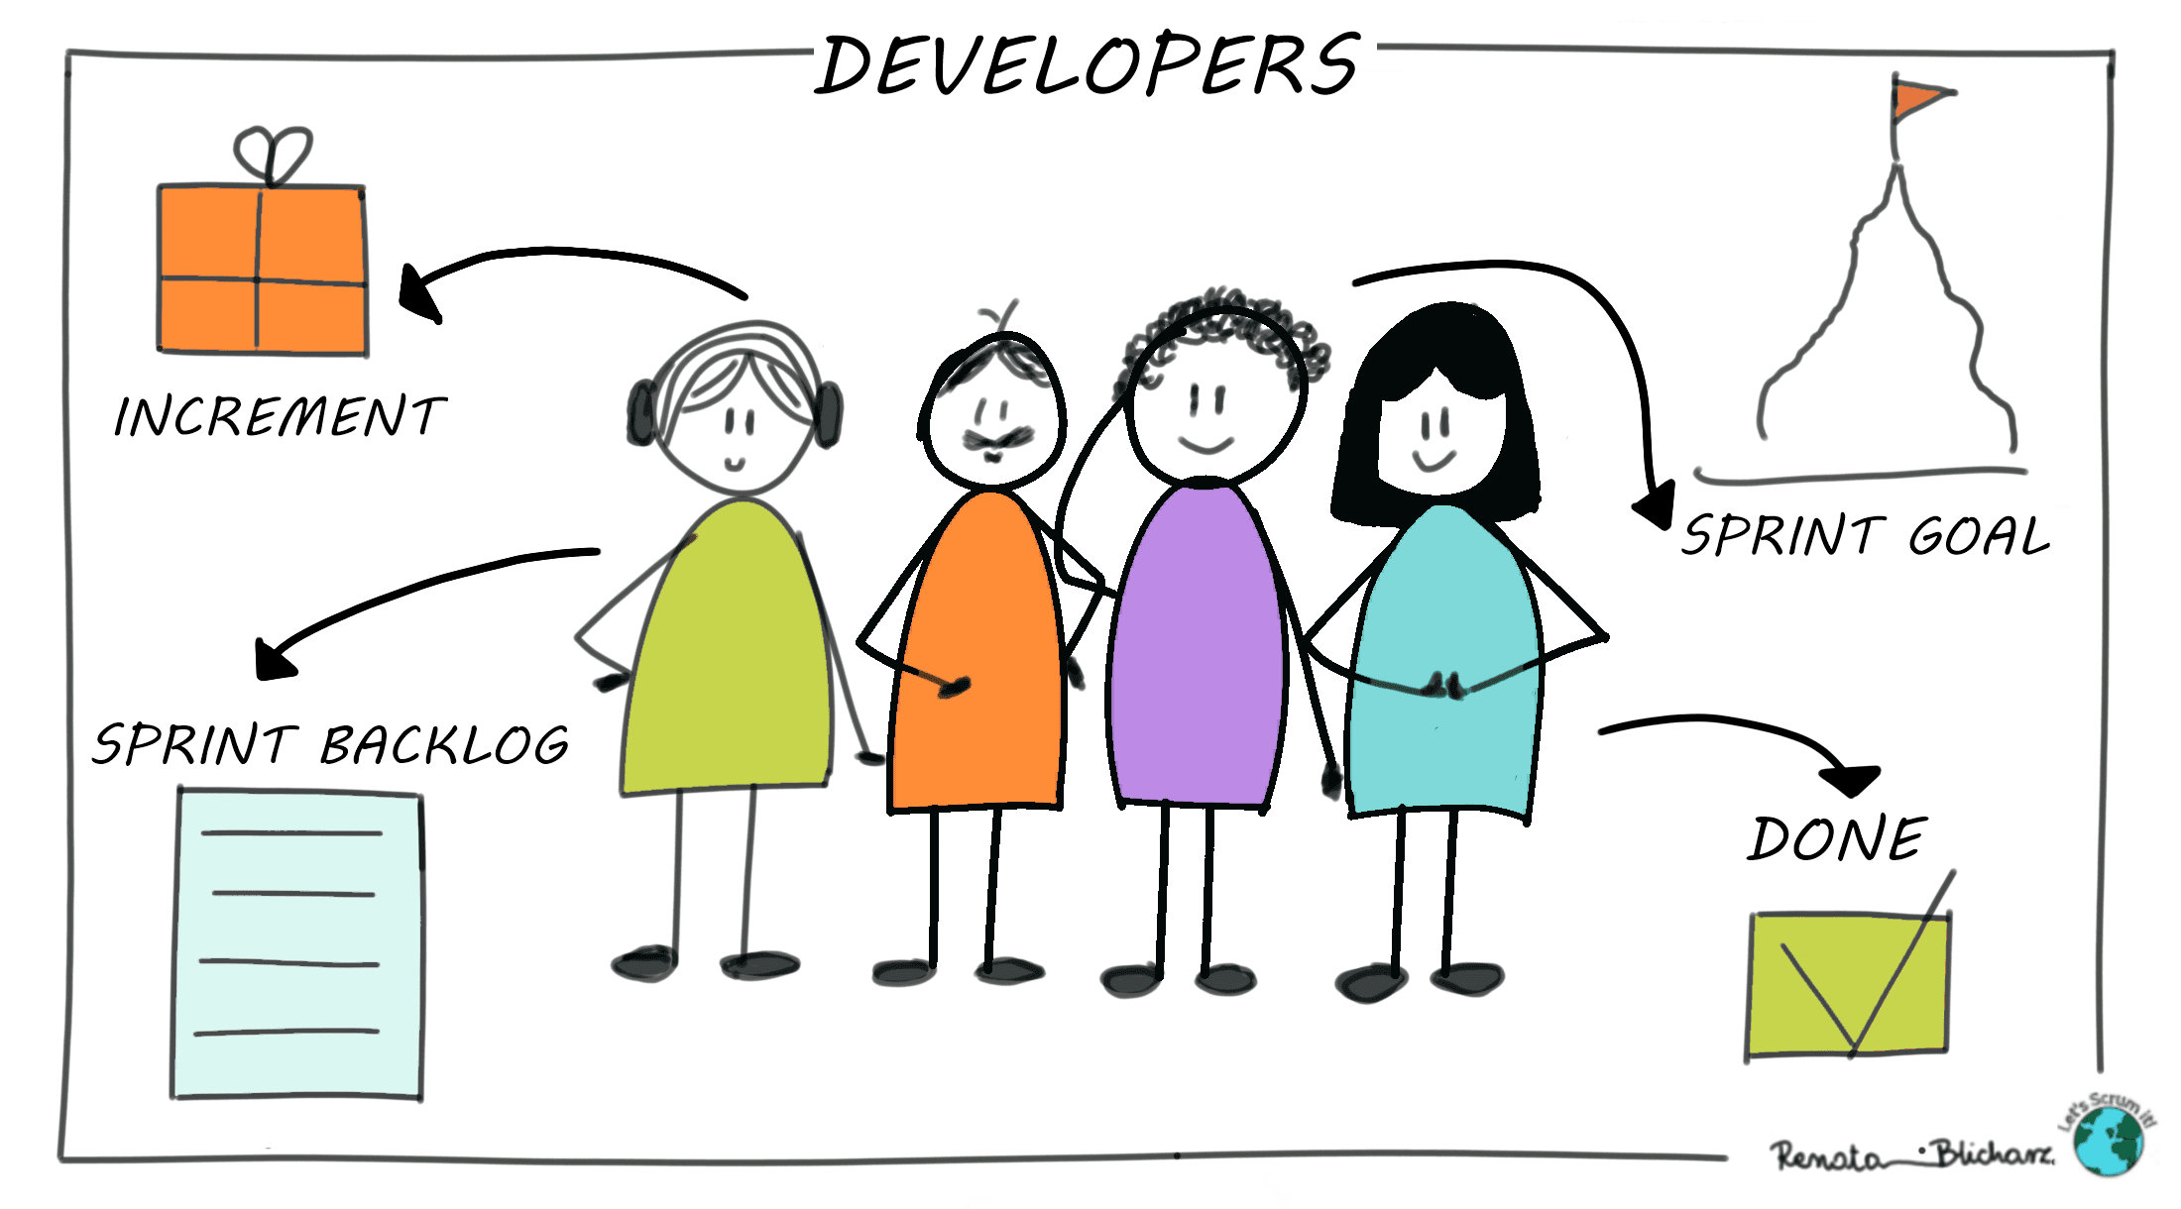
Scrum roles
Development Team
Responsibilities:
Self-organizing professionals who do the work of delivering a potentially releasable Increment.
Cross-functional with all skills necessary to create the product Increment.
Characteristics:
Typically consists of 3-9 members.
Collective ownership and accountability.

Slide 10
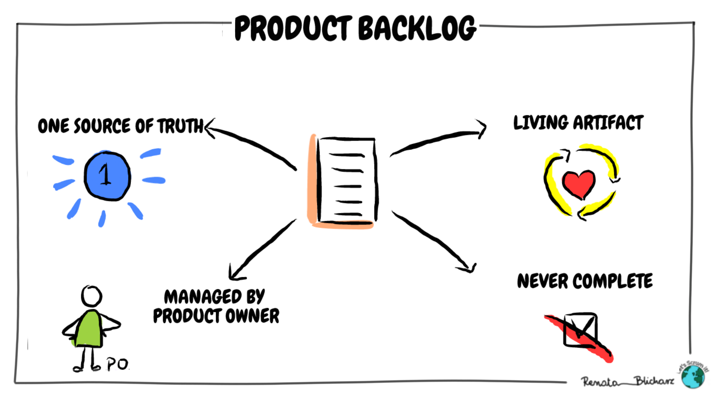
Scrum Artifacts
Product Backlog
The product backlog is all the features for the product, an ordered list of everything that is known to be needed in the product.
Characteristics:
  Dynamic; evolves as the product and environment do.
  Items include features, functions, requirements, enhancements, and fixes.

Slide 11
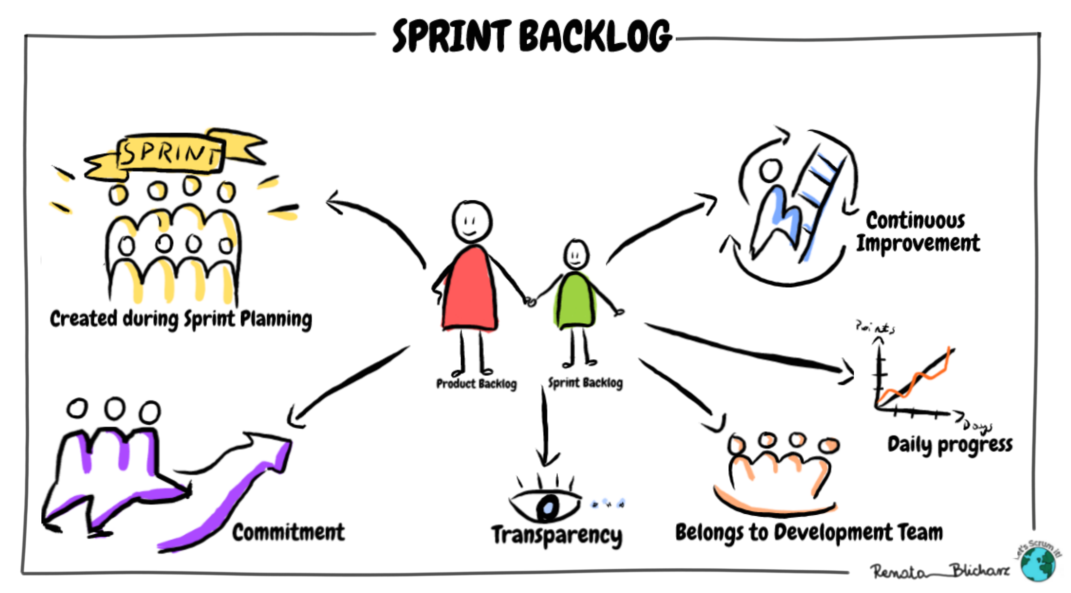
Scrum Artifacts
Sprint Backlog
The sprint backlog is all the features that will be worked on for that sprint, the set of Product Backlog items selected for the Sprint, plus a plan for delivering the product Increment.
Characteristics:
  Created during Sprint Planning.
  Owned and managed by the Development Team.
These should be broken down into discrete tasks:
  Fine-grained
  Estimated
  Assigned to individual team members
  Acceptance criteria should be defined
User stories are often used

Slide 12
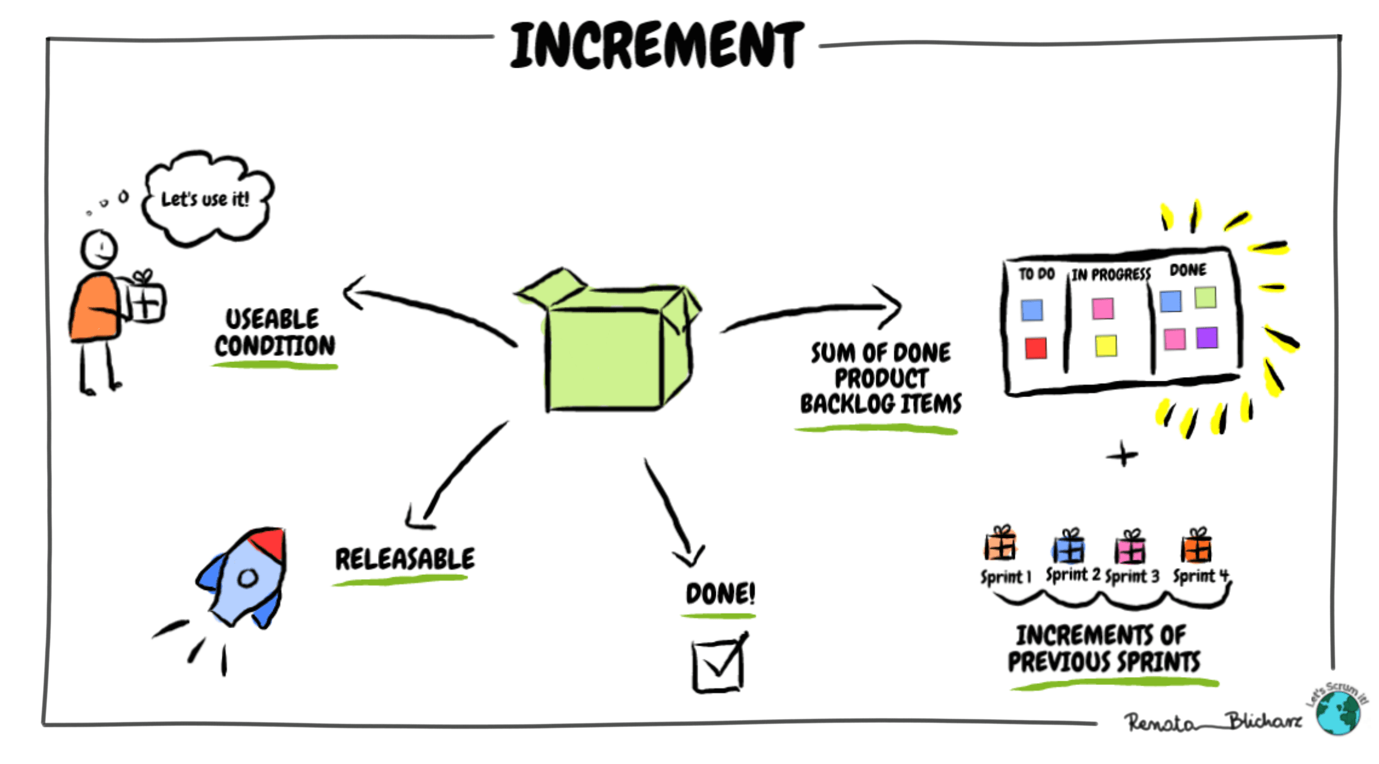
Scrum Artifacts
Increment
The sum of all the Product Backlog items completed during a Sprint and the value of the increments of all previous Sprints.
Characteristics:
  Must be in useable condition regardless of whether the Product Owner decides to release it.

Slide 13
Scrum Events
Scrum Meetings
Sprint Planning Meeting
  Entire Team decides together what to tackle for that sprint
Daily Scrum Meeting
  Quick Meeting to touch base on:
    What have I done? What am I doing next? What am I stuck on/need help?
Sprint Retrospective
  Review sprint process
Sprint Review Meeting
  Review product

Slide 14
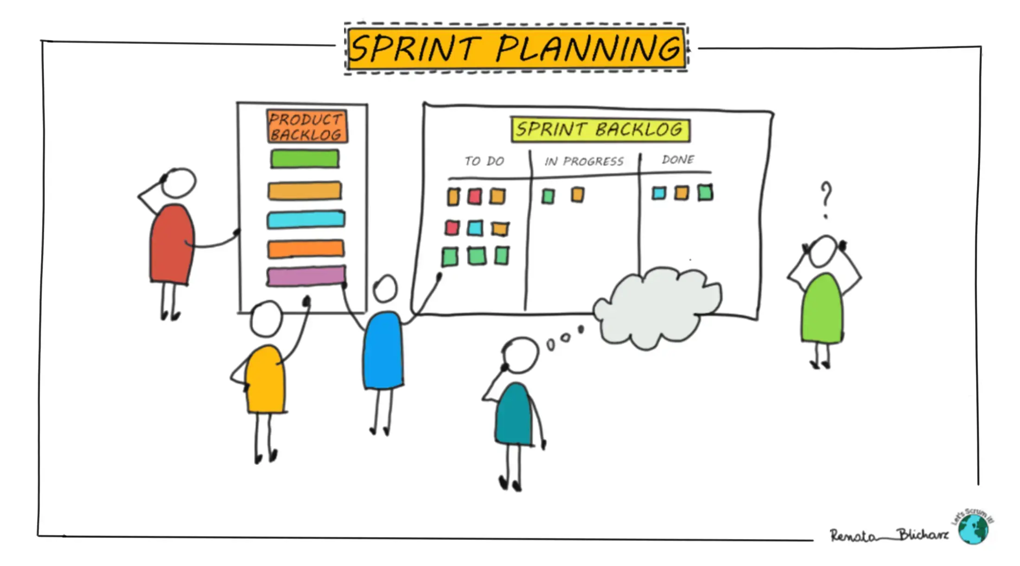
Scrum Events
Sprint Planning
Purpose:
  Define what can be delivered in the Sprint.
  Plan how the work will be achieved.
Time-box:
  Maximum of 8 hours for a one-month Sprint.
Activities:
  What: The Product Owner presents the desired Product Backlog items.
  How: The Development Team plans the work necessary to deliver the Increment.

Slide 15
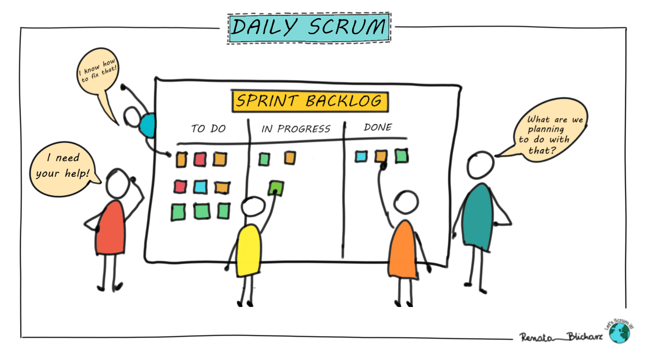
Scrum Events
Daily Stand-up (Daily Scrum)
Purpose:
  Synchronize activities and create a plan for the next 24 hours.
Time-box:
  15 minutes.
Questions Addressed:
  What did I do yesterday that helped the Development Team meet the Sprint Goal?
  What will I do today to help the Development Team meet the Sprint Goal?
  Do I see any impediment that prevents me or the Development Team from meeting the Sprint Goal?

Slide 16
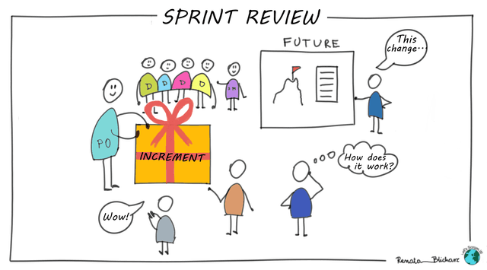
Scrum Events
Sprint review
Purpose:
  Inspect the Increment and adapt the Product Backlog if needed.
Time-box:
  Maximum of 4 hours for a one-month Sprint.
Activities:
  Demonstration of the Increment.
  Feedback from stakeholders.
  Discussion of what to do next.

Slide 17
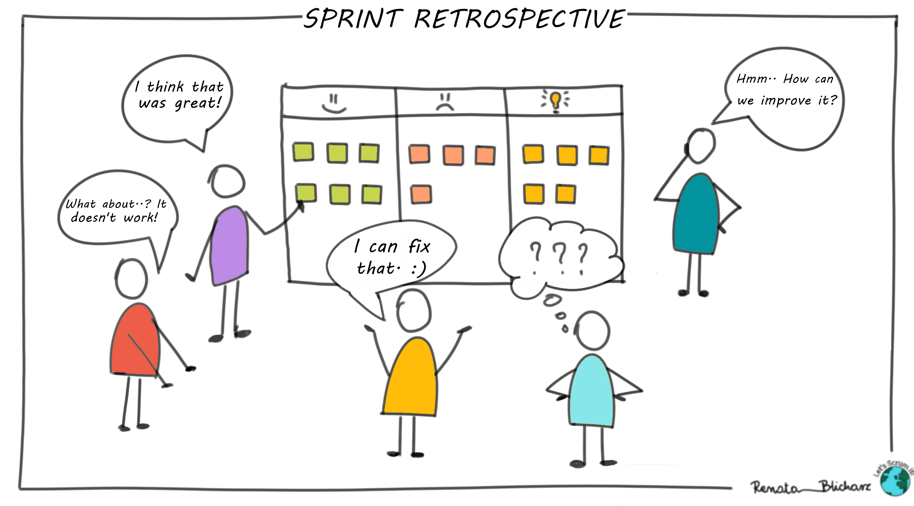
Scrum Events
Sprint Retrospective
Purpose:
  Plan ways to increase quality and effectiveness.
Time-box:
  Maximum of 3 hours for a one-month Sprint.
Activities:
  Inspect how the last Sprint went regarding people, relationships, processes, and tools.
  Identify and order major items that went well and potential improvements.
  Create a plan for implementing improvements.

Slide 18
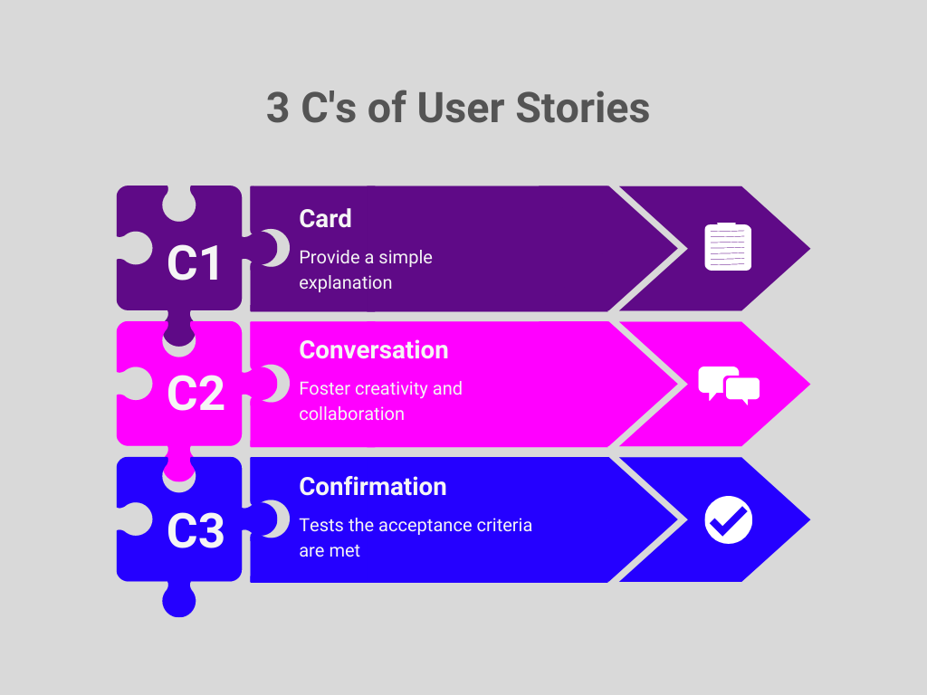
User Stories

Slide 19
User stories
Card — A short reminder of the requirement
The Card is a brief written description
It captures who, what, and why
It is not a detailed specification
“As a [role], I want [function], so that [value]”
Examples:
As a student, I want to see my grades, so that I can track my academic progress.
As a customer, I want to reset my password, so that I can regain account access.

Slide 20
User stories
Conversation — Shared understanding through discussion
Details emerge through conversation
Developers, Product Owner, and stakeholders collaborate
Questions clarify assumptions and edge cases
Examples:
For “see my grades”:
  Should grades be real-time?
  Who can view them?
  Can grades be downloaded?
For “reset password”:
  Email or SMS?
  Expiration time?
  Security verification needed?

Slide 21
User stories
Confirmation
Defines acceptance criteria
Ensures the story meets expectations
Used to verify completion
Examples:
Grade viewing is done when:
  Student sees grades for all enrolled courses
  Only the student can access them
  Data matches the official record
Password reset is done when:
  Reset link expires after 10 minutes
  User sets a new password successfully
  Old password no longer works

Slide 22
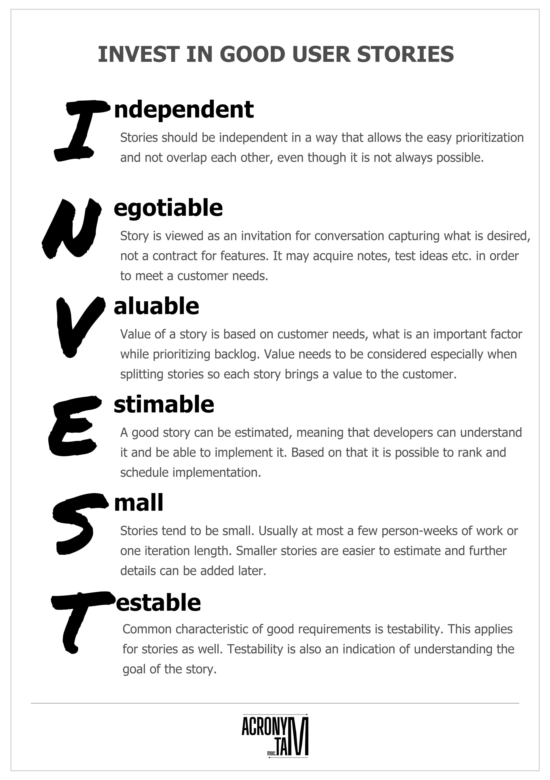
User stories
How to evaluate user story?

Slide 23
Benefits and challenges of implementing scrum
Benefits and Challenges
Benefits:
Increased Transparency: Regular meetings and artifacts make progress visible.
Flexibility and Adaptability: Ability to respond to changes quickly.
Improved Quality: Continuous testing and integration.
Higher Customer Satisfaction: Regular feedback and involvement.
Team Empowerment: Teams are self-organizing and make decisions.
Challenges:
Cultural Shift: Requires a change in mindset and company culture.
Role Misunderstandings: Confusion over responsibilities can hinder progress.
Resistance to Change: Team members or management may resist new processes.
Requires Discipline: Consistency in following Scrum practices is essential.
Scaling Issues: Applying Scrum to large projects or organizations can be complex.

Slide 24
References
Roger Pressman and Bruce Maxim. (2020). Software Engineering: A Practitioner's Approach. 9th E. McGraw- Hill. New York. ISBN: 9781259872976.

